Slide 1
Mini Project Management Sebastian Horl
Climate Change
Analysis of global warming
Aissaoui Ilhem
Master2 SIA
2021/2022
Notes:
Hello everyone, welcome to my presentation, today i’m going to talk about an important topic is the climat change

Slide 2
Presentation Outline
1
2
3
4
5
Introduction
Dataset Description
Languages
And
libraries
Data
Processing
and analysis
Conclusion
1
Notes:
To start i will introduce the subject, then i will describe my dataset , after that i ‘ll talk about the tools and libraries that i use to make the analysis, next i will explain some analysis that i have done , finally i’ll summerize my presentation

Slide 3
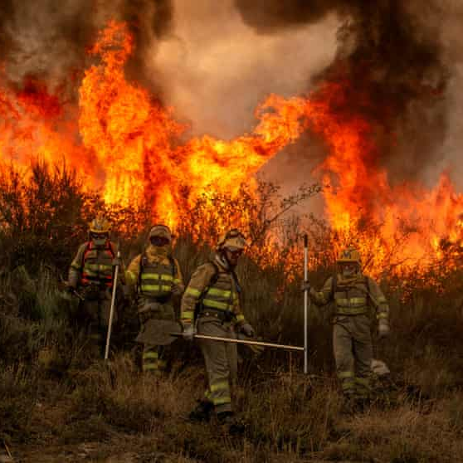
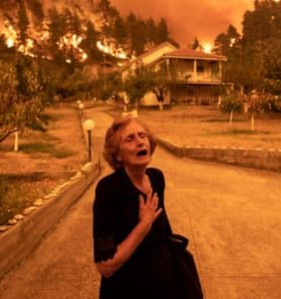
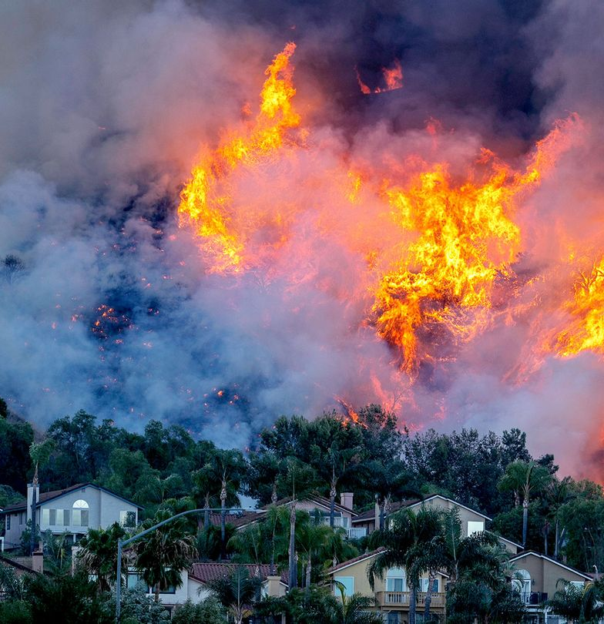
Summer 2021, Summer of fire
The 2021 wildfire season involves wildfires on multiple continents. Even at halfway through the calendar year, wildfire seasons were larger than in previous history,
2
Notes:
Everyone know the huge fires raged this summer many country, on Greece, Turkey, Italy and california and others have also been hit hard by forest fires. Because of the drought and rising temperatures, there are more and more mega-fires destroying entire regions and millions of hectares of forests.
Many scientists assume that this fires is clearly related to climate change, and these conditions will result in more vegetation drying out, and therefore more intense and harder to control fires. So After this giant firesI decided to take a look to the global temperatures and how exaclty are they evolving and have been evolving during the years.

Slide 4
Globale Warming and Climate Change
Climate change is the average of the weather conditions of a place over several years
The globale warming is the increase in average temperature of the earth
Main reason of the global warming is caused by humans using oil, gas and coal
they release greenhouse gases, mainly carbon dioxide (CO2)
3
Notes:
So let me clearify some definitions, the Climate change is the average of the weather conditions of a place over several years and The globale warming is the increase in average temperature of the earth
The speed of climate change we are currently seeing is caused by humans using oil, gas and coal for their homes, factories and transportation. When these fossil fuels burn, they release greenhouse gases, mainly carbon dioxide (CO2). These gases trap the sun's heat and cause the planet's temperature to rise.

Slide 5
Impacts of Climate Change
Increase in
Temperature
Crop Failure and water scarcity
sea level rise (because of massive ice mass loss)
Mass extinction of species
Some regions will become uninhabitable
More frequent floods and strong hurricanes
4
Notes:
So What is the impact of climate change ?
This climate change cause the increase in temperature, the sea level will rise because of massive ice mass will be loss so some regions will become uninhabitable, we will have frequent floood and strong hurricanes, and also we will lose many species of animal and fish, it cause also a crop failure and water scarcity

Slide 6

Dataset
GlobalTemperatures.csv
Contains the average temperature of land and oceans
GlobalLandTemperaturesByCity.csv
Contains the average temperature of country and states
Climate Change: Earth Surface Temperature Data
Exploring global temperatures since 1750
Country Mapping - ISO, Continent, Region
(for extract the iso code and mapping of country)
5
Notes:
So, to analyse the globale warning , i choose a open dataset from Kaggle website the Earth Surface Temperature Data which contains the earth temperature since 1750, I use also a open dataset Country Mapping to extract the iso code and mapping of country.
For the first dataset I use two csv files the global temperatures Contains the average temperature of land and oceans and the global temperature by state Contains the average temperature of country and citiestatess

Slide 7





Languages And Libraries
6
Notes:
I used python as a programming languages with jupyter notebook is an open-source web application that allows us to create and share documents that contain live code, equations, visualizations and narrative text.
and Library Panda that helps us load the data, prepare it and perform some lightweight analysis. I used Numpy - a library that lets us run blazing fast computation with vectors, matrices and other tensors. For visualization, i used matplotlib library, it allow you to write complicated stuff with convenience (e.g. super-detailed plots or custom animations), Plotly library to make interactive graphs

Slide 8
Data Processing
Drop the rows that have at least one missing value (he missing values are not significant in our dataset)
Aggregate the data frame to construct new field, the average change of temperature (level of devastating impacts)
1.5° C the level associated with less devastating impacts than higher levels of global warming beyond 1.5°C increasingly severe and expensive impacts
7
Notes:
For data processing, i droped the rows that have at least missing value, after that i aggregate the data to construct new filed is the average change of temperature which is the level associated with less devastating impacts than higher levels of global warming beyond 1.5°C increasingly severe and expensive impacts

Slide 9

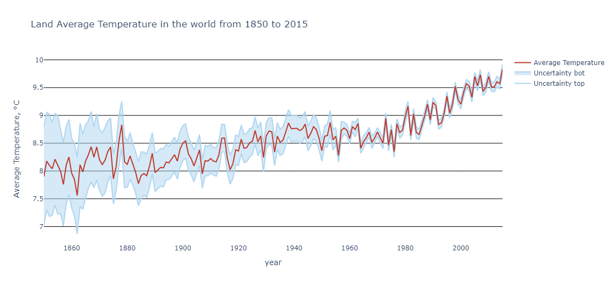
Is there a global warming?
8
Notes:
To analysis the temperature data , I tried to answer many question, first , Is there really a global warming?,
From the charts you'll see, that there's worldwide warming these days. The average temperature of Soil surface has the most noteworthy esteem within the final three centuries. The quickest temperature development happened within the final 30 a long time! This charts too have certainty interims, which appears that estimation of temperature has gotten to be more precise within the final few a long time.

Slide 10
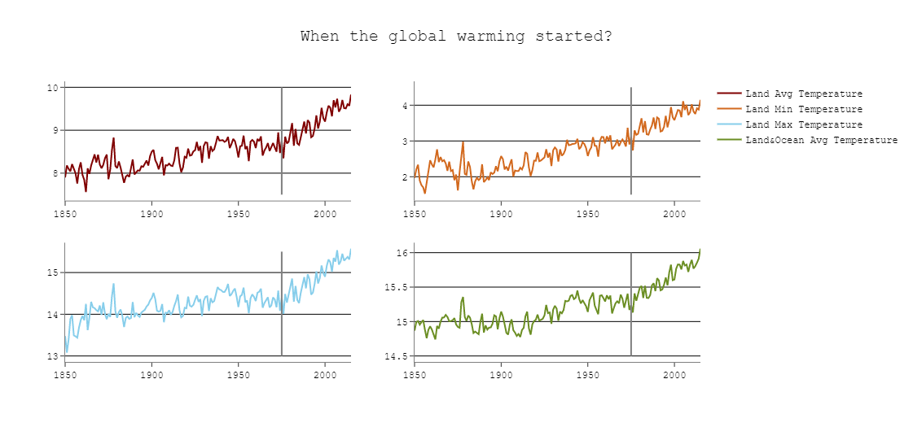
When did Global Warming Started?
9
Notes:
For the chart we see that the increase of temperature has explose in 1975, due the increase of the population and development of industry.

Slide 11
What is the trend of temperature change in the world?
10

Slide 12
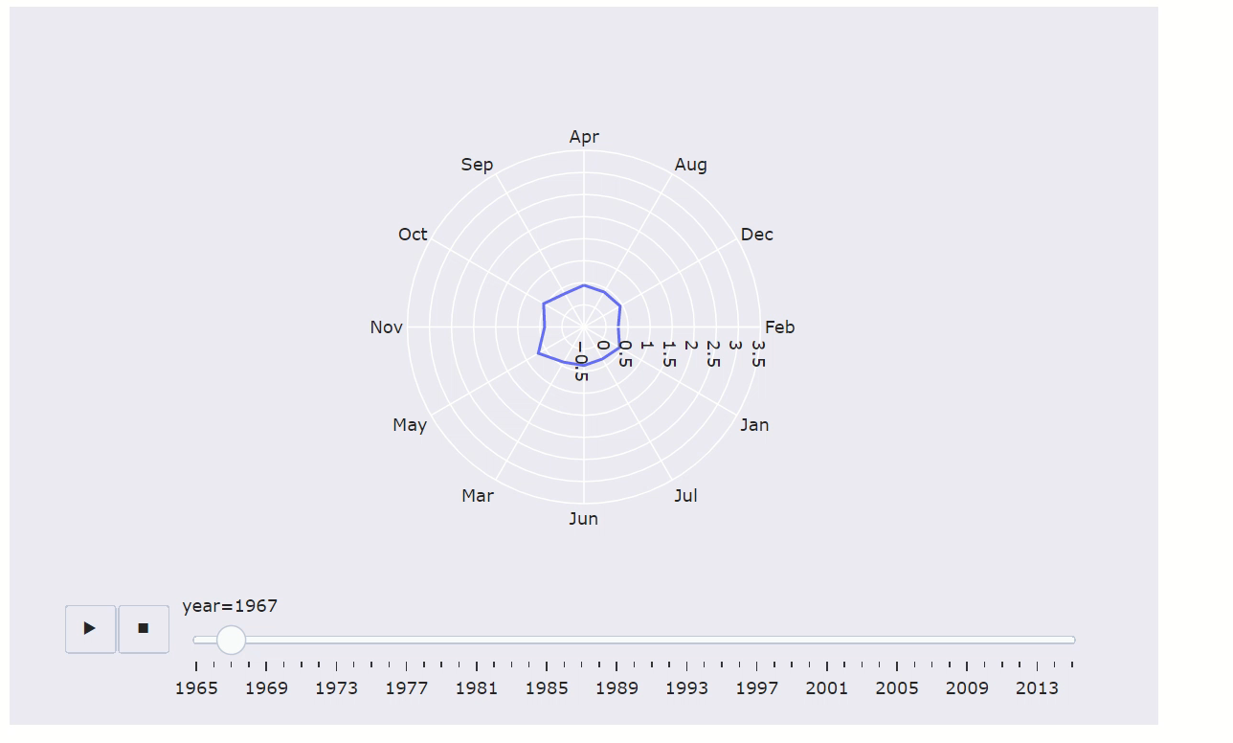
Notes:
I want to investigate how many historical records had in this decade to learn if global warming more speed last decade.
I selected 'World' records from 'Country Name' column. Then, I chose only monthly basis temperature change values and whole world records.
Result shows that already eight of the ten years in the current decade were among the ten hottest years on record in terms of mean annual temperatures. Additionally, Radar chart clearly shows how temperature change increased year by year.

Slide 13
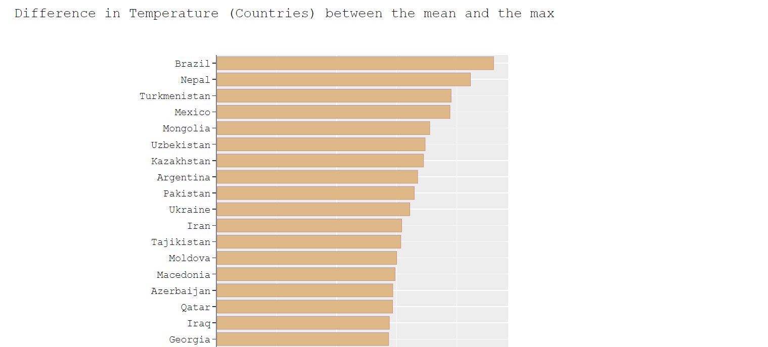
What are the most countries that suffer from temperature increasing ?
12
Notes:
Now, we analyze temperature by country, this is interesting:
Brazil - BIG is due deforestation issues (their wildfires have increased big time and the agriculture is the main factor)
Kazakhstan - place for testing biological and nuclear weapons by the soviets. Also, here are located the most polluting industries. Most of their water is infected by industrial and agricultural runoff and it is in some places radioactivity.
Turkmenistan - Desertification and drying of the Aral Sea, due to HEAVY agricultural practices.
Nepal - Air Pollution. 1 in 10 Nepalese suffer from chronic lung problem, and the life expectancy of a new born is shorter by 2 years due solely to problems air quality related.

Slide 14
Interactive Map of the countries - Temperature increase over the years
13
Notes:
Finnally, i make a interactive map

Slide 15
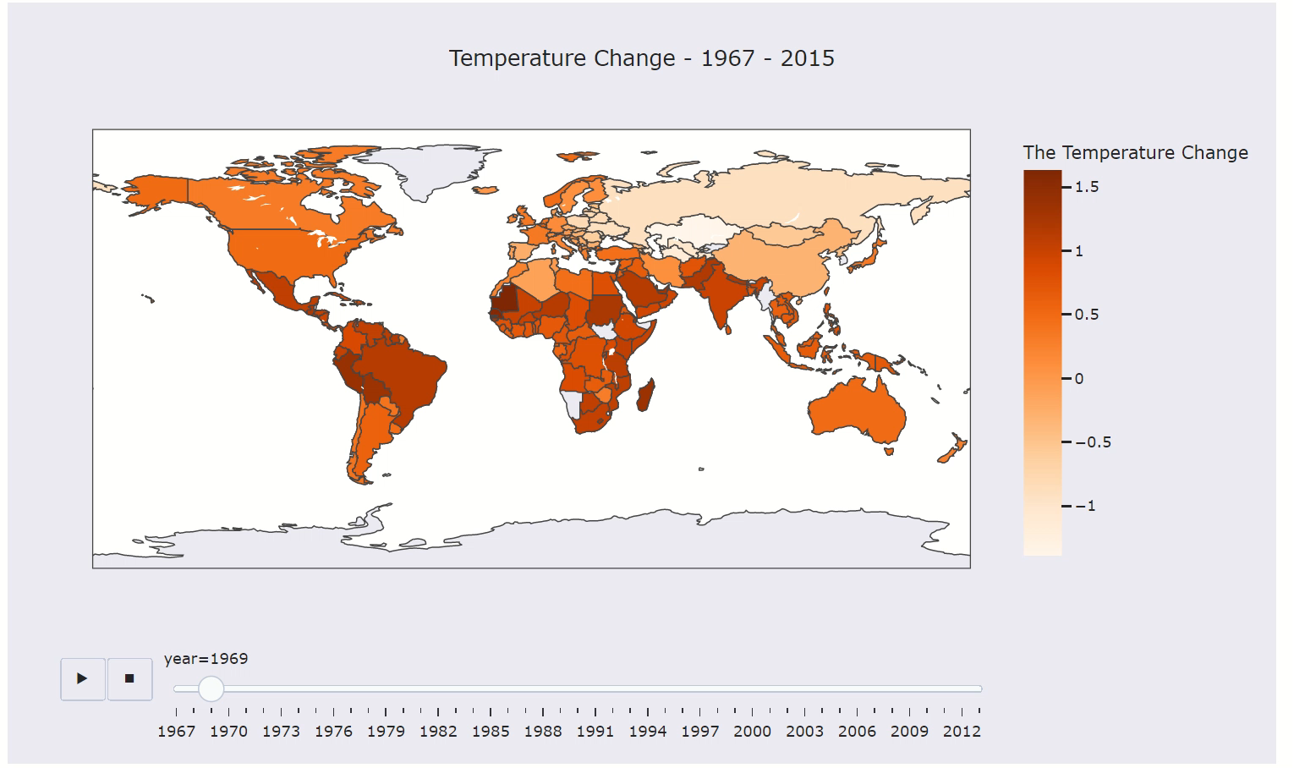
Notes:
During my analysis i was found that there has been a global increase trend in temperature, particularly over the last 30 years. This is due to the violent activities of a humankind.

Slide 16
Conclusion
Today we still have a chance to limit the global warming
15
Notes:
Today, we are on the brink of missing the opportunity to limit the global warming to 1.5 °C,
so the countries must take a step to change the strategy and make the global warming priority because
it is the single biggest risk that exists today.

Slide 17
Thanks!
Any questions?
16

